Slide 1
Card Scheme
A card scheme is a payment network that allows consumers to make payments with their credit and debit cards. It is a set of rules and regulations that govern the issuance, processing, and settlement of payments made with cards that carry the scheme's logo.
The most common card schemes are:
VISA
MASTERCARD
AMERICAN EXPRESS
DISCOVER

Slide 2
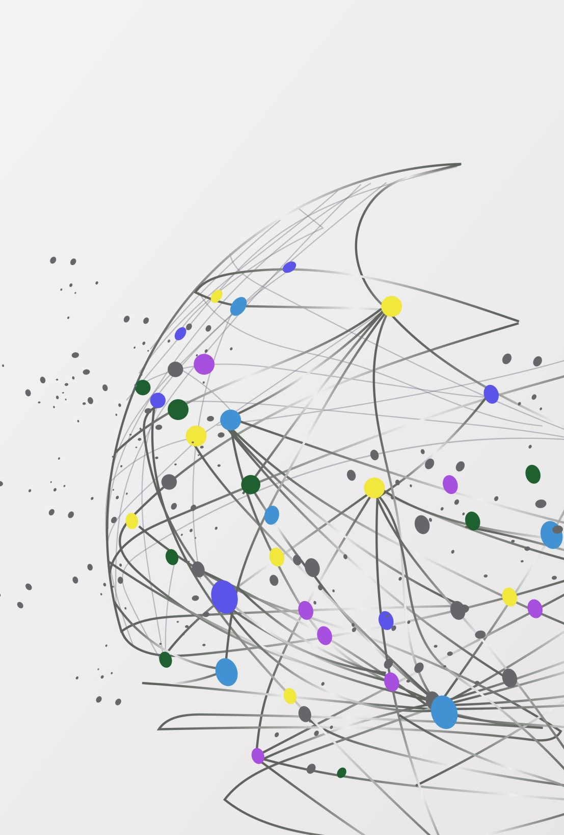
Types of Cards

Slide 3
Types Of Cards
2 basic types of card which is called Payment Instrument–
1| Physical Card
Credit card, Debit card, Prepaid card, Gift card etc... Physical cards are several types: Magnetic Stripe Card, Chip Card, Contact/Contactless, NFC etc...
2| Virtual Card
Doesn’t have physical existence but have an Account Number(PAN) and can do everything like a physical card and have CVV for card verification when performing transaction. Example- Digital wallet, Mobile banking, virtual gift card (Steam Card, Epic Gift Card etc.…)

Slide 4
Types Of Cards
Credit Card
A credit card is issued by a bank and, suggestively, acts as a line of credit (or loan) from the bank to you. With this card, you are only able to make payments up to a set monthly credit limit.
Debit Cards
A debit card is linked to your current bank account or checking account. Unlike a credit card, a debit card enables you to pay by deducting money from the associated account. This means you can only spend or withdraw funds that you already own.
Prepaid Card
Like debit cards, prepaid cards are issued by a financial institution (Visa, for instance) and hold a deposit of funds that you can use to make purchases or payments. The main difference between a prepaid and a debit card is that once the funds deposited on a prepaid card have been spent, the card can no longer be used until more money is added.

Slide 5
Types Of Cards
Virtual Cards
Virtual cards are a non-physical payment instrument replacing physical cards and cash. A virtual card is the same as a credit or a debit card, but only exists as a set of data including the 16-digit card number, an expiration date, and a CVV code. You can not withdraw cash using a virtual card.
Gift Cards
Similar to prepaid cards, gift cards are also pre-loaded with funds. What makes a gift card different is that once the money is spent, you cannot reload a gift card and you can no longer use it. Gift cards were originally issued by a store and could only be used in that particular location. Presently however, major card issuers like American Express, Visa, or Discover are also offering gift cards which can be used anywhere.

Slide 6
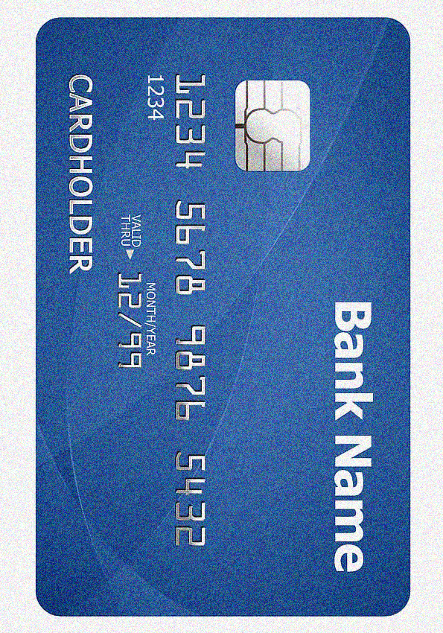
Physical Cards
Magnetic Stripe cards
The Magnetic Stripe card stores card data on the magnetic stripe present on the card which is easily readable(Not Safe & easy to clone) and not readable on Magstripe damage.
There are 3 track of these MagStripe on Card system. 1| Track 1, 2| Track 2 and 3| track 3.
EMV Chip Cards
EMV Cards are essential smart payment cards also known as IC cards. They prevent cloning of the card. EMV Stands for EUROPay, Mastarcard, VISA.

Slide 7
Physical Cards
Contact/Contactless Smart Card
Contact smart cards required to insert the card for identification purposes. Conversely, contactless smart cards, which are commonly known as RFID (radio frequency ID), only required to be near the scanner for reading.

Slide 8
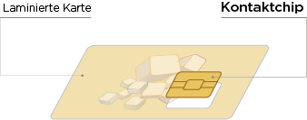
Chip Card
The embedded security chip holds encrypted data and makes EMV technology extremely difficult to duplicate. The stored transaction codes are dynamic, meaning they change and are never used twice, which keeps the data from ever becoming compromised.

Slide 9
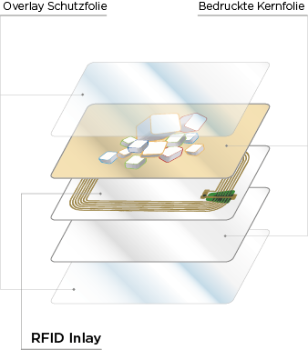
RFID Card
RFID (radio-frequency identification) chip cards are cards that don’t require direct contact with the corresponding reader for data exchange. RFID cards have 3 different ranges: Close Coupling (up to 10cm), Remote Coupling (up to 1m) and Long Rage (over 1m). RFID allows transmission from an active reader to a passive storage medium (card). With a magnetic field, the passive chip card gets power and can be read out.

Slide 10
NFC Card
Near field communication (NFC) is part of RFID technology and refers to a standard created by the contactless payment function. NFC ranges from 1-4 cm to a maximum of 10 cm – depending on the chip type. This ensures that data is not transferred unintentionally. In addition, NFC transmission also allows data to be received, unlike RFID.

Slide 11
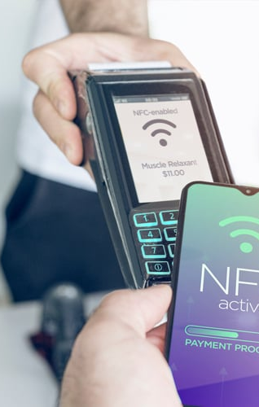
NFC Supported Cards
Near-field communication (NFC) business cards enable you to share your contact information with a single tap. NFC business cards have two components: a digital business card and an NFC tag.
NFC tags come in several forms, like stickers, pop sockets, keychains, and physical cards. They contain tiny microchips, and when tapped to another smartphone, the information paired with your tag (like the link to your business card) automatically appears.
NFC facility could be used in smartphone, smart watch also.

Slide 12
Frequently Asked Questions on the Difference Between NFC and RFID
Where are the NFC solutions most widely used?
Due to the close proximity function of the NFC, the electronic readers are capable of detecting tags from a few centimeters only. That is why NFC solutions are widely used in secure communications and in customer sectors for contactless payments.
How can NFC and RFID be differentiated on the basis of the volume of data read?
RFID solutions are designed to read batches of electronic tags at one time. On the other hand, NFC reads a single electronic tag at a time.
State one prominent use for each of NFC and RFID.
RFID solutions are primarily employed for identification purposes. For instance, in inventory management, attendee tracking, and car speed detection. NFC technology is used for communication purposes, such as contactless payment and mobile wallets.

Slide 13
NFC Vs RFID
Reading of data
Data in huge volumes or batches can be read by RFID technology and thus proves beneficial for tasks like inventory management. On the other hand, NFC can read a single tag at one time. Even though NFC qualifies as a time-consuming reader, it serves well in contactless payment procedures.
Frequency of devices
RFID is operational under various ranges of frequencies, including low frequency (125-134 kHz), high frequency (up to 13MHz), and ultra-high frequency (up to 960 MHz). RFID is also operated from 10 centimeters to 100 meters of range. In contrast, the NFC is functional only up to the high-frequency range.

Slide 14
Difference Between RFID and NFC in Tabular Form
RFID | NFC
RFID is equipped to read electronic tags up to a large distance. | NFC operates on a reduced range.
RFID primarily supports the one-way type of communication. | Both one-way and two-way communication can be undertaken by NFC.
A bulk number of tags can be scanned at a time with RFID technology. | Only one electronic tag can be read by NFC readers at a time.
RFID technologies are not supplied with a huge storage capacity. | NFC solutions are equipped with vast storage space and thus can transmit more data.
RFID solutions are expensive due to their long-range functions and bulk scanning system. | Due to the reduced distance range, the NFC readers come cheaper as compared to RFID readers.

Slide 15
Types Of NFC & RFID
RFID / NFC cards
RFID cards fundamentally differ from contact cards. The chip card is read or written without physical contact to the device, resulting in less wear and a longer life. In addition, in the case of an RFID / NFC card, the chip is usually implanted “invisibly” into the card. The chip is “welded in” during the lamination production process.
Contacted IC chip cards and smart cards
In the case of a contact-type IC chip card, a cavity is milled into a conventional plastic card and then the corresponding chip is inserted with an adhesive. To do this, the plastic card must comply with ISO standard ISO-7816 and have a minimum thickness of 0.8mm or 800μ. Simple memory chips or cryptographic processor chips for secure applications can be used.

Slide 16
Types NFC Vs RFID
Hybrid chip cards
Hybrid cards can link different technologies together, here it depends on which ones are combined. Depending on the storage medium, the card is structured differently. If one combines a contact-type chip with a contactless chip, the invisible contactless chip is welded in during the production process. The visible contact chip is then glued into the free-milled location. The chips are not connected.

Slide 17
Types NFC Vs RFID
Dual interface chip cards
Dual interface cards have two production options. Either via the direct contact of the antenna to the chip (flexible bump or wire bonding) or via the “inductive coupling” method. With the “Flexbump”, the chip with the module is firmly connected to the antenna already laminated in the card. In the case of inducitive coupling technique, the chip module itself already has a small miniature antenna which interacts with the large antenna in the card body and thus transmits the data and energy.

Slide 18
Different chip types in smart cards
Basically, a distinction is made between contactless NFC (RFID), contact smart cards and dual interface cards. Whereby contactless NFC (RFID) cards manage to work without a visible chip and can transmit stored data without contact to a terminal. Contacted smart cards, have a visible chip (best known from bank cards) and must be plugged into a corresponding terminal. Dual interface cards have a visible and an invisible chip and combine both technologies.

Slide 19
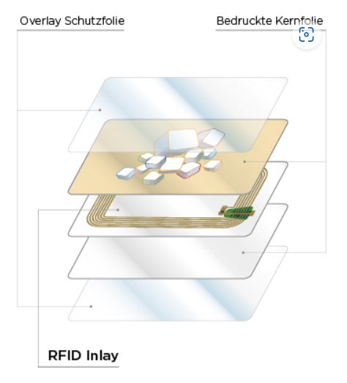
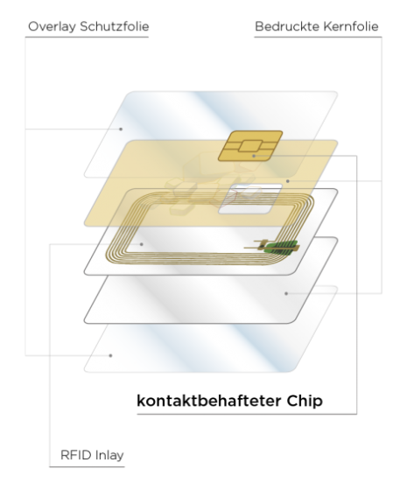
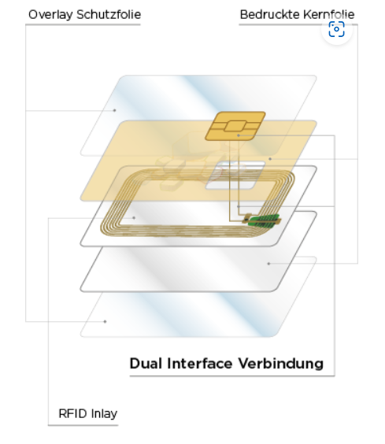
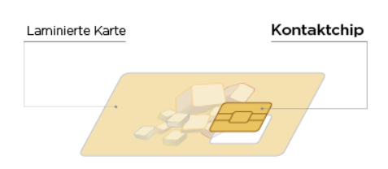
Different chip types in smart cards
Contacted IC chip cards and smart cards
RFID / NFC cards
Hybrid chip cards
Dual interface chip cards

Slide 20
EMV Chip Card vs. Magnetic Stripe Card
EMV Chip Card | Magnetic Stripe Card
Card is inserted into the terminal. | Card is swiped.
Terminal contacts the chip inside the card using pins. | The terminal sends an authorization request (including the customer’s card data) to the acquiring bank.
Chip is activated, terminal verifies the issuer from the chip on the card. | The terminal sends an authorization request (including the customer’s card data) to the acquiring bank.
Chip verifies PIN details. | The terminal facilitates an authorization response from the issuing bank to the acquiring bank.
Terminal signs transaction with a public key provided from the chip. | The terminal facilitates an authorization response from the acquiring bank to the terminal.
Information is sent to the bank for official authorization. | Assuming the authorization responses weren’t turned down for any reason, the transaction completes.
The transaction is completed.

Slide 21
Additional EMV card benefits
Upgrading is easy and cost-effective. EMV-certified terminals start as low as $200 as discussed in this article, and depending on your setup, your existing hardware can become EMV-certified with a custom integration. Reduce costly chargebacks. If you have better transaction security, you’ll deal with less fraud and fewer chargebacks. A few years ago, credit card network rules were updated to place more financial risk on merchants without chip cards for lost or stolen transactions. If you’re late to switching to EMV, you’re at risk of seeing chargebacks continue to increase and will lose cases at a much higher rate. Don’t underestimate how quickly those costs can add up! Protect customers and build trust. Switching to chip cards is more than just saving money and reducing chargebacks — it’s about protecting your customers. As mentioned, EMV-equipped transactions are unique, ensuring that charges are never duplicated or faked. Plus, less fraud means fewer headaches from disputes and better service for your customers.

Slide 22
Chip Card Security Features
1. EMV is designed to prevent fraud.
2. Chip cards are hard to clone.
3. Chip and Pin credit cards have sophisticated encryption.
4. Online transactions are largely unaffected by the EMV chip technology.
5. Chip card usually have larger memory & reliability.
6. More information Security, Privacy and Ease of use is ensured.
7. Reduced cost for operators and users
8. The EMV Liability shift, now pays for fraud losses if they don’t use an EMV chip reader to process transaction.

Slide 23
Card Tracks

Slide 24
Card Tracks
A track is a line on the magnetic stripe over which encoded data are recoded. There are 3 tracks on magnetic stripe, which are referred serially as
Track-1,
Track-2
Track-3.
The standards define the recording density of each track and it varies for each track. The recording density is referred to as BPI, or bits-per-inch.

Slide 25
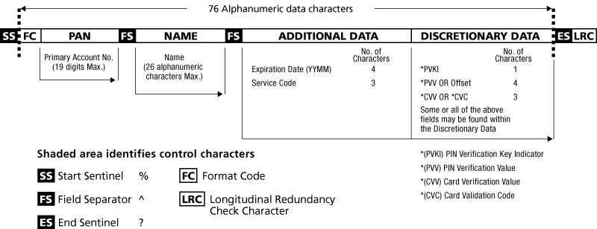
Track 1
Track-1 contains alphanumeric characters, recorded at 210 BPI at 7 bits per character.
In case of a credit card, this track normally encodes the cardholder’s name, card number and card expiry date. Field separator and placeholder characters are also found on the track.
Debit cards also contain the same information but to avoid delay in issuing a card when a customer opens an account, Banks now-a-days keep readymade cards.

Slide 26
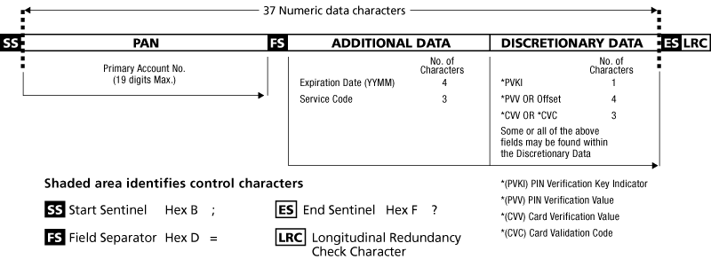
Track 2
Track-2 contains only numeric data, recorded at 75 BPI at 5 bits per character. It’s limit is 40 characters. This track contains cardholder’s card number and expiry date. While these two pieces of data are also found on Track-1, the reasons for placing them on Track-2 are twofold. Firstly, it provides an extra degree of redundancy on the card, should one of the tracks be erased or become unreadable.

Slide 27
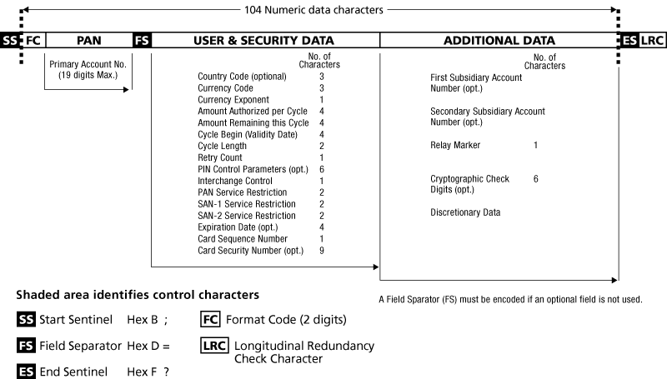
Track 2
Track-3 is used rarely, if at all, and its content is numeric only, recoded at 210 BPI, 5 bits per character.

Slide 28
Card Payment Lifecycle

Slide 29
Card Payment Lifecycle
The card payment life cycle is the process that occurs when a customer uses a credit or debit card to make a purchase.
The life cycle typically includes the following steps:
Authorization,
Batching,
Clearing ,
Settlement,
Funding.

Slide 30
Card Payment Lifecycle
Authorization
The merchant sends the card information to the acquiring bank, which then forwards it to the card network. The card network validates the information and sends an authorization request to the issuing bank. The issuing bank checks the customer's account balance and approves or declines the transaction.
Batching
The acquiring bank collects all of the authorized transactions for a period of time (usually one day) and submits them to the card network in a batch.
Clearing
The card network sends the batch of transactions to the issuing banks for clearing. The issuing banks verify the transactions and debit the customer's accounts.

Slide 31
Card Payment Lifecycle
Settlement
The card network settles the transactions between the acquiring banks and the issuing banks. The acquiring banks pay the issuing banks for the authorized transactions.
Funding
The acquiring banks fund the merchant's account for the authorized transactions. The merchant can then withdraw the funds from their account.

Slide 32
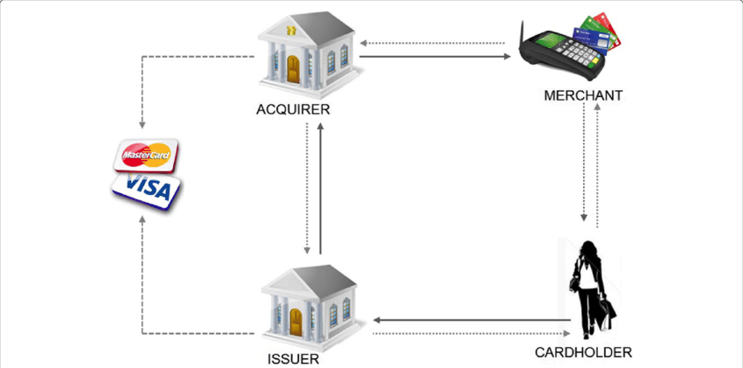
Card Payment Lifecycle

